Slide 1

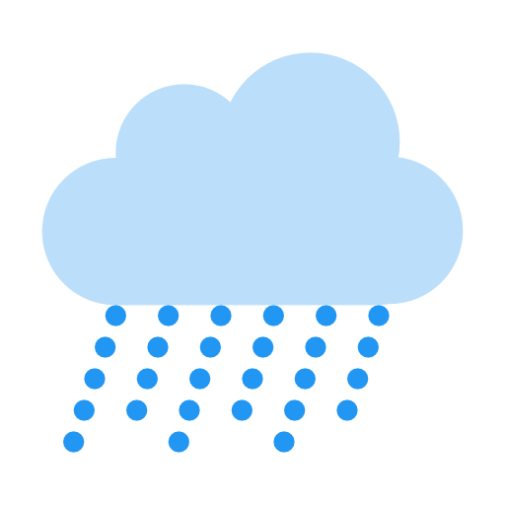
Should you pay attention to the weather forecast?
Boston
80º
Monday
Tue
Wed
Thu
Fri
Sat
Sun
Dooti Roy*, Gregory Vaughan#, Junxian Geng*, Jianan Hu* and Xiaoyan Liu*
*Boehringer Ingelheim Inc.
# Bentley University

Slide 2




BACKGROUND
In the history weather dataset:
For 113 locations around the United States:
Daily highs and lows for temperature
The total amount of precipitation in inches
Jul 15th, 2014 - Sep 1st, 2017
In the forecast dataset:
Rolling predictions for:
Daily highs & lows for temperature
The probability of precipitation
Up to 8 days later
For each day being forecast,
Two predictions are made, one for the morning, and one for the afternoon
Additional historical information:
Humidity, wind speed, cloud cover, dew point, sea level and visibility miles

Slide 3
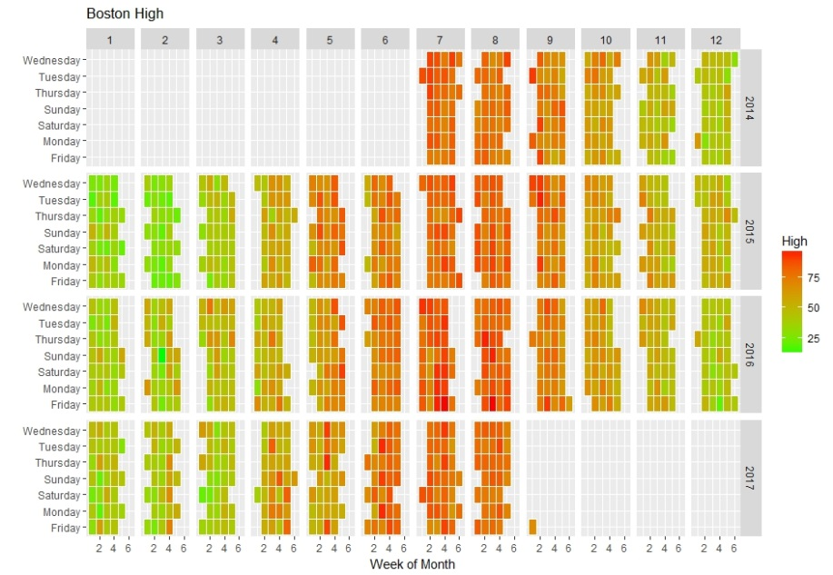
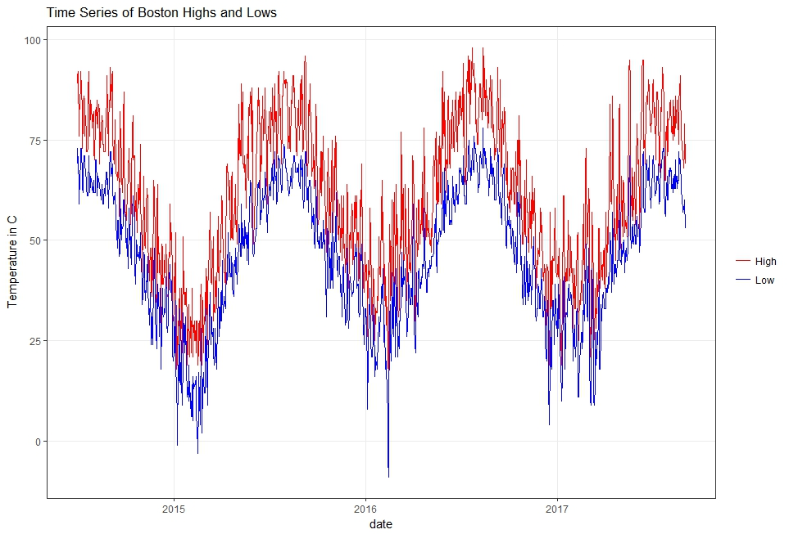
TEMPERATURE: EXPLORATION
Overall pattern during 3 years
Actual vs. Predicted
Forecast may be improved

Slide 4
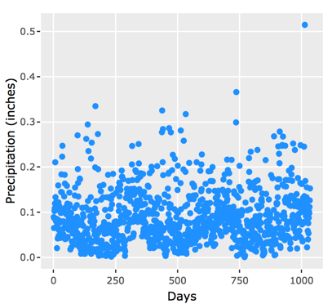
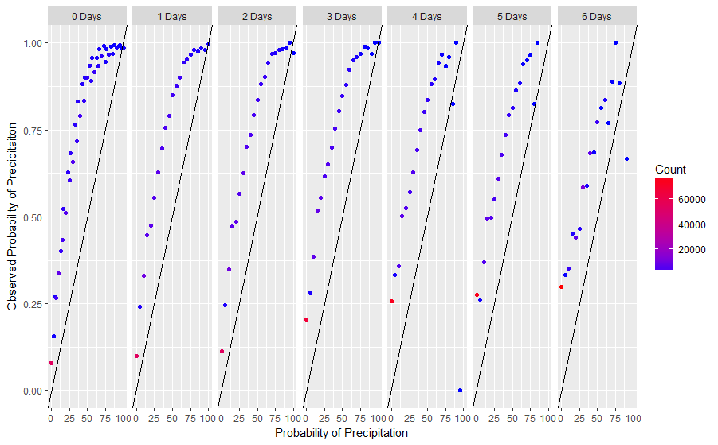
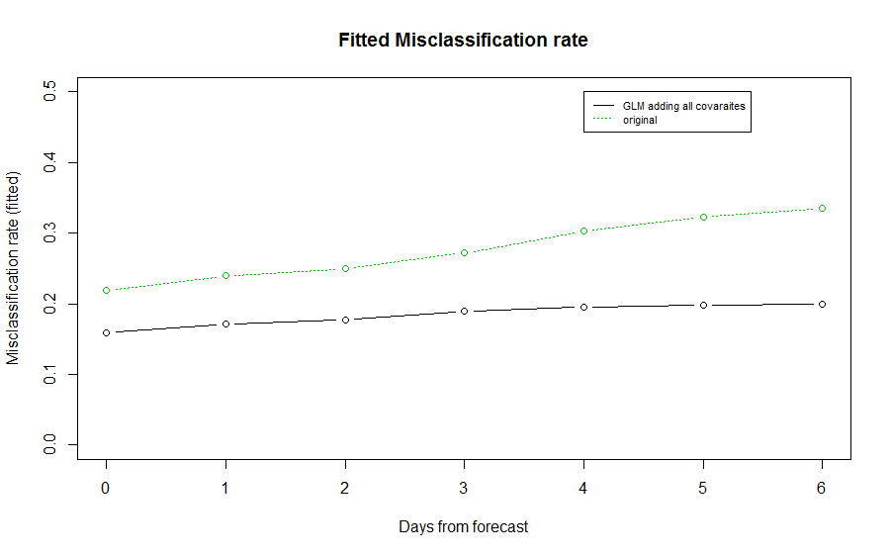
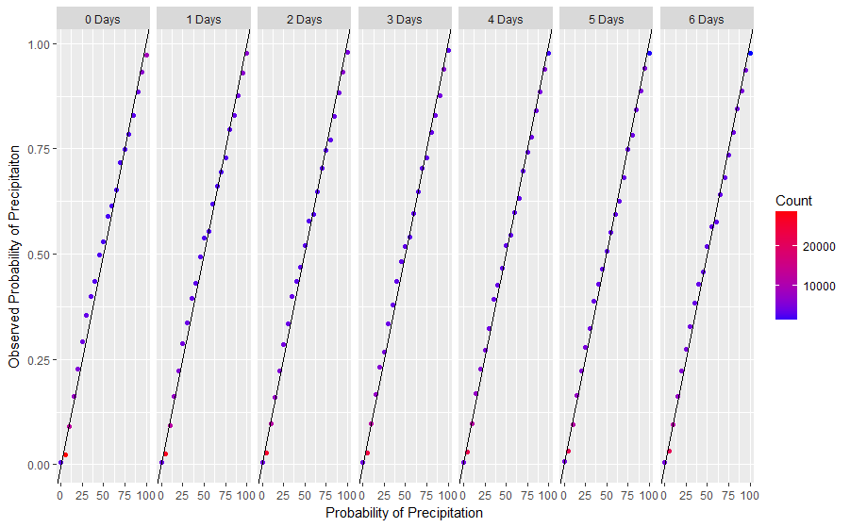
PRECIPITATION: EXPLORATION
Overall pattern during 3 years
Original prediction
Misclassification rate
Updated prediction

Slide 5
DISCUSSION
01.
02.
The original forecast tends to underestimate the chance of rain.
There is a lot of variability in forecasts for temperatures.
As the gap between the prediction date and the forecast date increases, the forecast grows worse.
03.
04.
Different locations have slightly different distributions of temperature or rain, but overall patterns are similar to each other.
No clear changes in the distributions of temperature/rain over the 3 years that the data was collected.
05.
The prediction models of temperature and rain can be improved by considering additional information.

Slide 6
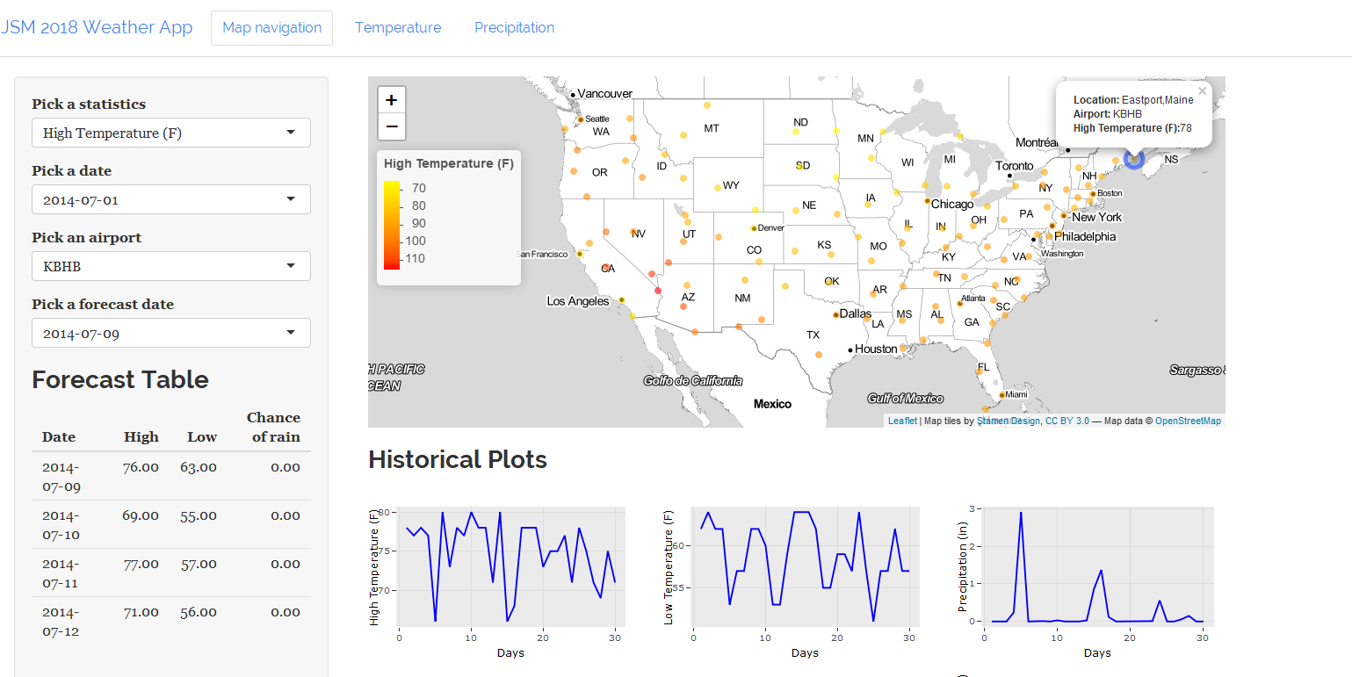
JSM WEATHER APP

Slide 7
REASONS FOR VISITING OUR POSTER Session # 215941
Learn more about weather patterns
Deep dive with our interactive App!
Learn about forecast error distribution
Can the forecasts be improved?
Understand the statistics behind it all

